Slide 1
Role of Speech Technology in Enhancing Human-Computer Interactions in Tamil
G. Anushiya Rachel
Project Officer
Speech Lab, SSN College of Engineering

Slide 2
Introduction
Human-computer interactions
Graphical user interface
Voice user interface
Communicate with computers/machines as with a human being through speech
Personal assistants such as Siri, Google assistant, Cortana, Alexa
Requirements of the computer
Recognize user’s voice/speech (speaker/speech recognition)
Respond appropriately through speech (speech synthesis)
Possible application of speech: Speech recognition/synthesis, speaker verification/identification, language identification, emotion recognition/synthesis
Presently, text-to-speech (TTS) synthesis systems, a restricted vocabulary speech recognition system, and a speech-enabled enquiry system developed for Tamil

Slide 3
Text-to-Speech Synthesis
Converts any given text in a language to speech
Basic components
Text pre-processing
Text to phonetic-prosodic translation
Signal processing component to generate speech
Language dependent and independent modules
Restricted and unrestricted domain synthesizers

Slide 4
Unit Selection Synthesis (USS)
Waveform concatenation approach
Pre-recorded speech units combined based on the given text, such that target and concatenation costs are reduced
Speech units could be words or sub-word units (eg: phonemes, CV units, syllables)
Synthesized speech
Natural
Contains glitches at the concatenation points
Larger speech unit – better quality
Large footprint size (in the order of GBs)
Larger speech unit – more amount of data required

Slide 5
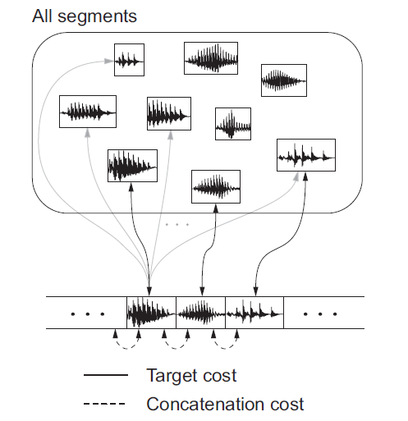
Unit Selection Synthesis (USS)

Slide 6
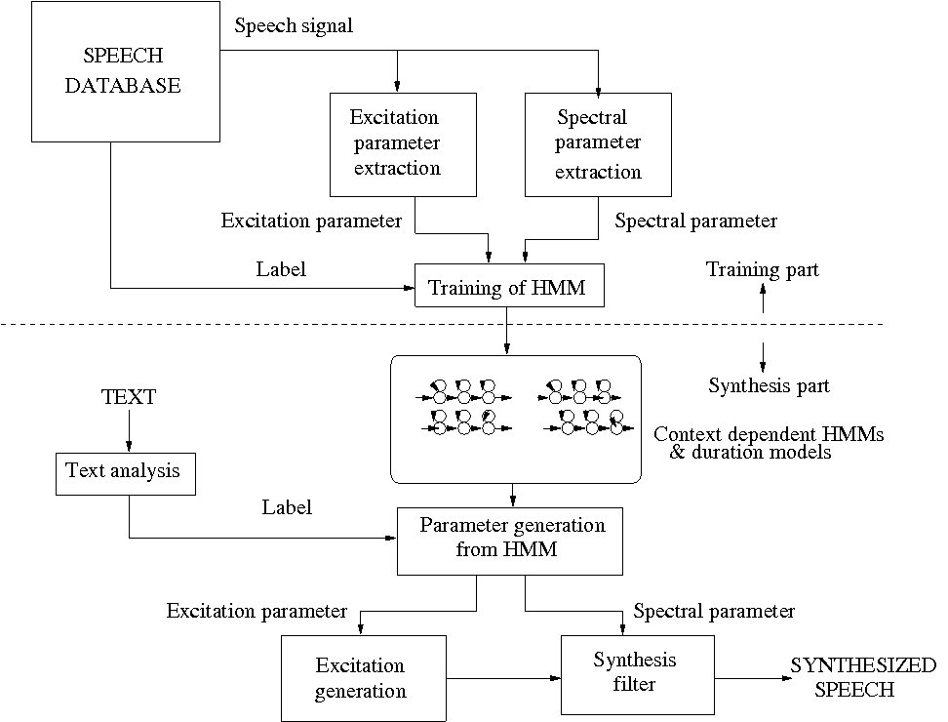
HMM-Based Speech Synthesis System (HTS)
Statistical parametric approach
Uses source-filter model to synthesize speech
Synthesized speech
Highly intelligible
Slightly less natural
Small footprint size (in the order of few kBs)

Slide 7
Requirements
Text data
Domain specific or unrestricted
Speech data
Record in quiet/studio environment
Amount of data
Basic unit could be phone, diphone, syllable, etc.
Larger the unit greater the amount of training data
Letter-to-sound rules of the language
Time aligned transcriptions

Slide 8
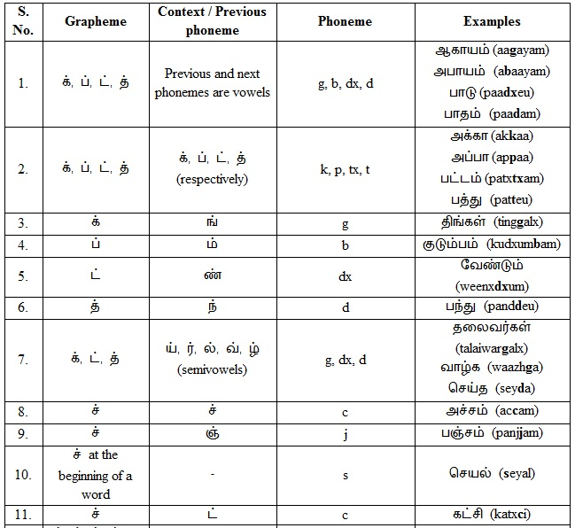
Letter-to-sound rules

Slide 9
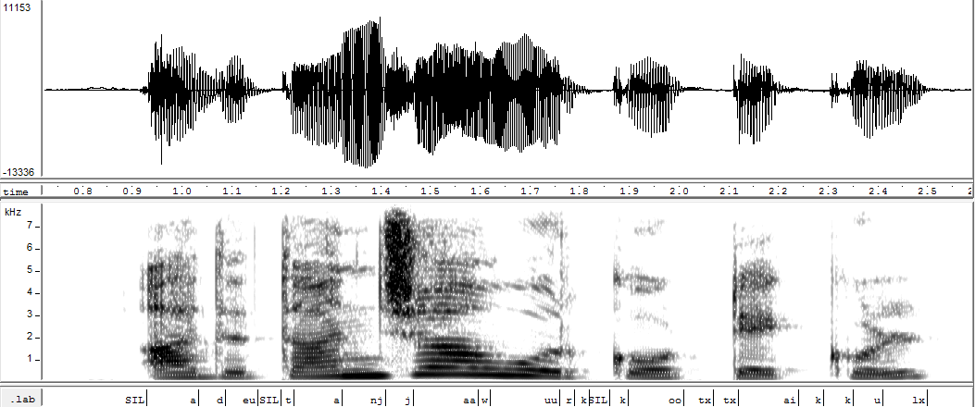
Time-Aligned Transcriptions

Slide 10
HMM-Based Speech Synthesis
Effect of context information on quality
Monophone – context independent (/aa/ /g/ /aa/ /y/ /a/ /m/)
Triphone – right and left contexts (/x-aa+g/ /aa-g+aa/ /g-aa+y/ ….)
Pentaphone – 2 contexts to right and left
Pentaphone with additional features
Web demo: http://speech.ssn.edu.in
Prosody modification
To improve naturalness of speech, pitch contour can be modified
Emotions can also be incorporated

Slide 11
Polyglot HTS
Bilingual synthesizers for Tamil and Indian English
Tamil phonemes mapped to similar Indian English phonemes
Separate synthesizers for Tamil and English
Perceptually similar phonemes merged
Acoustically similar phonemes merged
Polyglot synthesizers for Tamil, Hindi, Malayalam, Telugu
GMM-based voice conversion used
Characteristics of each speaker adapted to desired speaker’s characteristics

Slide 12
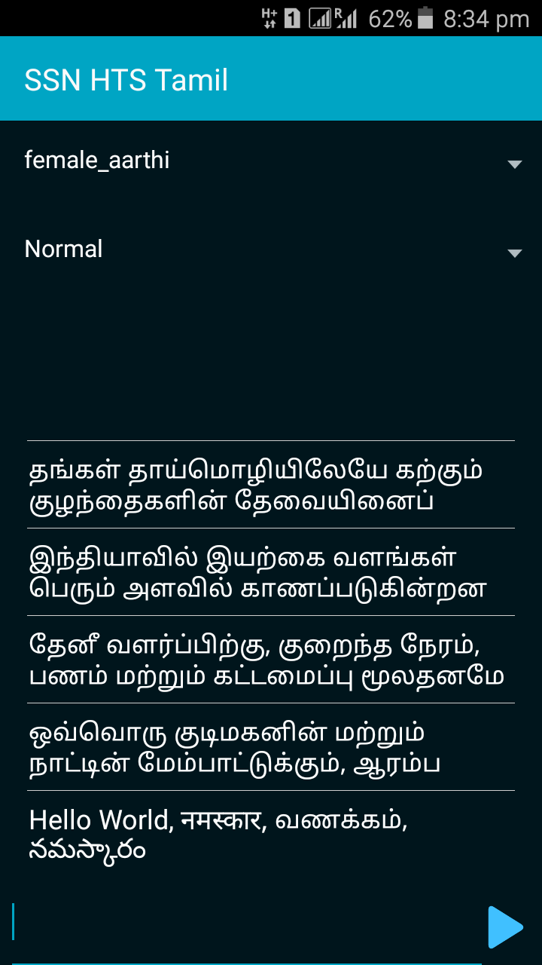
Mobile Application and Screen Reader
Android mobile application allows the user to type the desired text and synthesizes it.
Tamil TTS system is integrated with the “Talkback” feature in Android phones, which serves as a screen-reader
Linux-based screen reader that synthesizes selected text has also been developed.

Slide 13
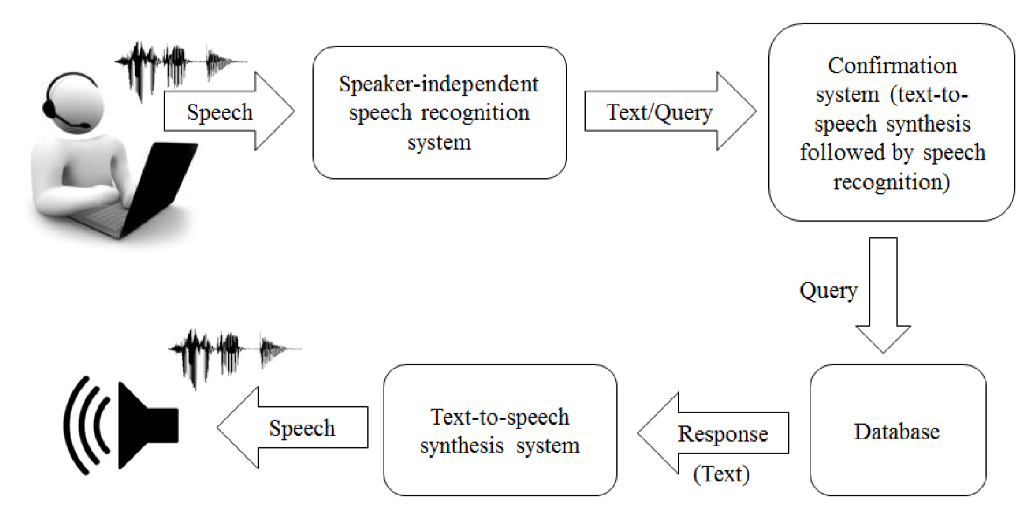
Speech-Enabled Interactive Enquiry System
Communicates to the user entirely through speech
Consists of three components - speech recognition system, TTS synthesis system, and database containing relevant information

Slide 14
Speech-Enabled Interactive Enquiry System
Developed to provide information on agriculture, specifically, paddy, sugarcane, and ragi
Obtains user’s query through a series of questions
Questions formulated such that they elicit 1 to 3-word responses
Garbage models used to eliminate out-of-vocabulary words
Recognized result verified from the user in the event of a doubt
Information relevant to the user’s query fetched from a database and synthesized by the TTS system

Slide 15
Future Directions
Development of an unrestricted vocabulary speech recognition system for Tamil
Identification of emotions from speech
Synthesis of emotional speech

Slide 16
Demo

